Slide 1

Academic Paper Abstract Classifier
Transformer-Based Web Application
GROUP - 1
Flask • Transformers • Hugging Face • Python

Slide 2

Project Overview
What It Does
Why It Matters
An intelligent AI-powered tool that automatically analyzes academic paper abstracts to determine their research domain and evaluate the sentiment expressed in the writing.
Academic researchers and institutions process thousands of papers annually. Automated classification streamlines literature review, helps identify research trends, and enables better organization of scholarly work.
The system leverages state-of-the-art transformer models to provide instant, accurate classification results through an intuitive web interface.
Understanding sentiment provides insight into how authors frame their findings—whether optimistic about breakthroughs or cautious about limitations.

Slide 3





Technology Stack
Flask Framework
Frontend Stack
Jinja2 Templating
Lightweight Python web framework powering the backend API and routing system, handling requests efficiently with minimal overhead.
Responsive HTML5, CSS3, and JavaScript create a clean, intuitive user interface with real-time updates and dynamic content rendering.
Server-side template engine seamlessly integrates Python logic with HTML, enabling dynamic page generation and data binding.
Hugging Face
DistilBERT Model
Industry-leading NLP library providing access to pre-trained transformer models with simple, production-ready APIs.
Fine-tuned distilbert-base-uncased-sst-2-english model delivers accurate sentiment analysis optimized for efficiency and speed.

Slide 4





System Architecture
User Interface
Results Display
Formatted output with confidence scores
Researcher inputs abstract text through clean web
interface
Flask Backend
Sentiment Analysis
Transformer model evaluates emotional tone
Server processes request and routes to appropriate modules
Field Detection
Identifies academic domain using keyword analysis

Slide 5

Frontend User Interface
Input Panel
Results Panel
Multi-line text area for abstract entry
Detected academic field with visual badge
Sentiment classification (Positive/Negative)
Real-time character counter (0-5000 chars)
Confidence score as percentage
Color-coded sentiment indicators
Sample abstract selector dropdown
Responsive layout adapts to screen size
Clear button for quick reset
Submit button triggers analysis
The interface emphasizes clarity and usability, allowing researchers to focus on insights rather than navigation complexity.

Slide 6
Backend Processing Workflow
01
02
03
Text Reception
Input Validation
Field Detection
Flask endpoint receives POST request containing abstract text from frontend form submission
Server validates text length, checks for empty inputs, and sanitizes content to prevent injection attacks
Keyword matching algorithm scans abstract for domain-specific terminology to classify research area
04
05
Sentiment Analysis
Results Rendering
DistilBERT model tokenizes text and generates sentiment prediction with confidence probability
Jinja2 templates format classification results and render dynamic HTML response to client
Average processing time: 0.8 seconds from submission to results display

Slide 7
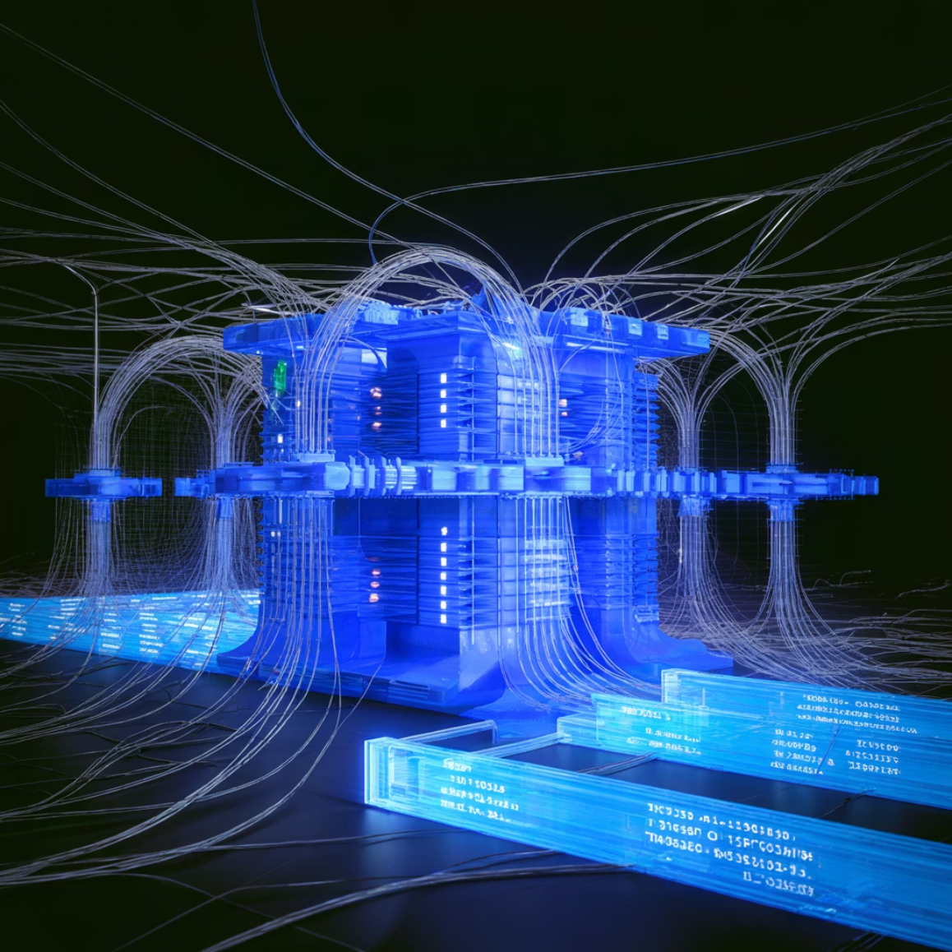
Machine Learning Model Details
DistilBERT Architecture
A distilled version of BERT that retains 97% of language understanding while being 40% smaller and 60% faster. This makes it ideal for production environments requiring both accuracy and speed.
Fine-Tuning Details
Pre-trained on the Stanford Sentiment Treebank (SST-2) dataset containing 67,000+ movie reviews, the model adapts well to academic text sentiment.
Output Classes
Confidence Score
Binary classification: Positive or Negative sentiment
Probability distribution across classes (0-100%)
Token Limit
Inference Speed
Maximum 512 tokens per input sequence
~200ms per abstract on CPU

Slide 8






Key Features
Real-Time Character Count
Dynamic Sentiment UI
Live feedback as users' type, preventing over-length submissions and improving UX
Color-coded results with visual indicators make sentiment immediately recognizable
Field Classification
Secure Authentication
Automatic domain detection across multiple academic disciplines using keyword analysis
Session-based logout system protects user data and maintains
privacy
Two-Panel Design
Hugging Face Integration
Clean separation between input and results creates intuitive information architecture
Seamless API connection to industry-standard transformer models ensures reliability

Slide 9


Future Enhancements
Security & Performance
Feature Expansion
CSRF Protection
Sample Library
Implement token-based security to prevent cross-site request
forgery attacks
Auto-populate dropdown with diverse example abstracts from various
fields
Loading Indicators
Batch Processing
Add animated spinners during model inference to improve
perceived performance
Enable CSV upload for classifying multiple abstracts simultaneously
Rate Limiting
Export Functionality
Protect API endpoints from abuse with request throttling
Download results as JSON, CSV, or PDF for record-keeping
Classification History: Store past analyses with timestamps, allowing users to track their research literature review progress over time.

Slide 10
Conclusion
97%
0.8s
512
Model Accuracy
Processing Speed
Token Capacity
Sentiment classification performance on test data
Average end-to-end analysis time
Maximum abstract length supported
System Impact
The Academic Paper Abstract Classifier demonstrates how modern NLP technologies can streamline scholarly research workflows. By combining intuitive design with powerful transformer models, the system delivers high accuracy classification in under a second.
Future integration possibilities include connecting with reference management systems, institutional repositories, and broader research workflow platforms to create an end-to-end literature analysis pipeline.

Slide 11
Thank You

